Slide 1
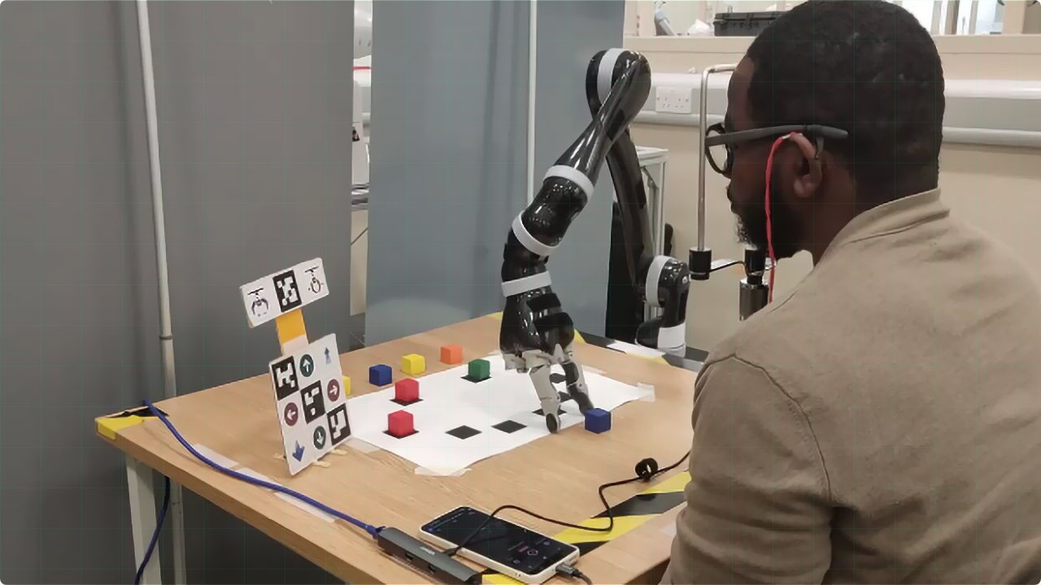

FalconEye:
Intelligent Tracking Robot
Milestone 2 Presentation
A.Manisanthan (23BD1A1207)
Mentor: Sai krishna

Slide 2



Project Overview & Foundation
Key Insights from Research
What is FalconEye?
The foundational paper introduces the power of combining open-vocabulary models (like DINO/CLIP) with segmentation models (like SAM). This enables flexible, zero-shot detection of *any* object without pre-defined classes.
An intelligent robotic system for real-time, open-vocabulary object detection, tracking, and following.
Core Goal
To create a system that accepts queries in text, image, or click form, and autonomously follows the specified object using a rover.
FalconEye's Relevance
We adopt this multimodal query and robust tracking approach for autonomous navigation. A key concept is adjusting the rover's velocity based on the object's distance, which we implement in our control loop.

Slide 3

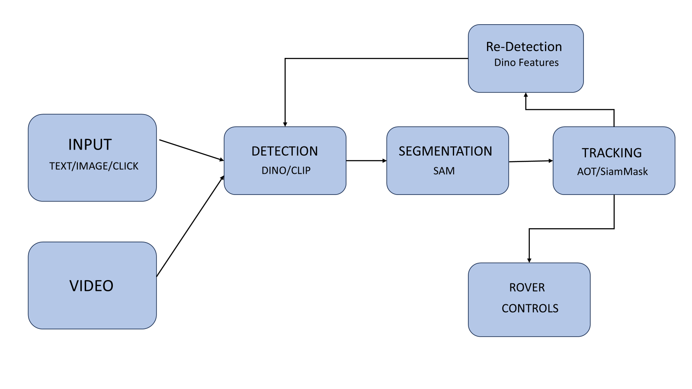
Final Architecture Diagram
Data Flow
»
Input: User provides a query (Text, Image, or Click).
»
Perception: The query is processed by CLIP/DINO to identify the object. SAM segments it.
»
Tracking: AOT/SiamMask tracks the object's bounding box across frames.
»
Re-Detection: If lost, DINO features are used to find the object again.
»
Control: A ROS node calculates velocity commands and sends them to the rover.

Slide 4



Technology Stack & Tools
Languages
AI & CV Frameworks
Robotics & Tools
Python, C++ (for ROS)
PyTorch, TensorFlow, Scikit-learn, OpenCV
ROS (Robot Operating System), Jupyter, VS Code, GitHub

Slide 5

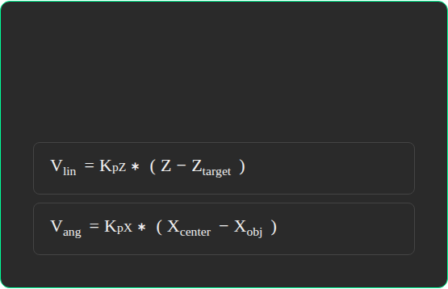
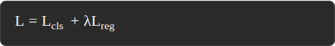
Mathematical Foundation
Tracking Algorithm
Proportional Control
The tracker minimizes a loss function combining classification (is it the object?) and regression (where is the bounding box?).
The rover's velocity is proportionally adjusted based on the object's distance (Z) and horizontal error (X).

Slide 6
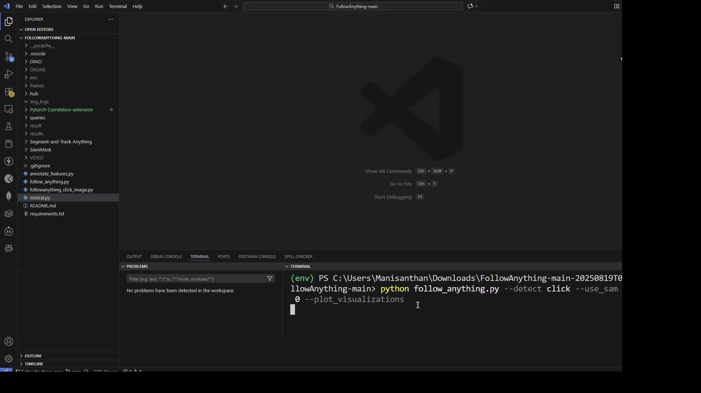
Live Implementation Demo

Slide 7
Demo Highlights
What was shown in the live demonstration:
Multimodal Input: Demonstrating text ("person in red shirt"), image, and click queries.
Real-time Tracking: The system successfully locks onto and follows the object.
Occlusion Handling: The object is hidden and re-detected upon reappearance.
Rover Control: The KMIT Self-Driving Rover autonomously adjusts its position to follow the target.

Slide 8


Our Contributions & Improvements
Key Learnings
Improvements on Paper
Gained deep experience integrating complex foundation models (SAM, DINO) for real-time perception.
Real-time Control Loop: Integrated the perception pipeline into a closed-loop ROS system for autonomous robotics, which was not the paper's focus.
Learned the challenges of optimizing CV models for real-time inference on resource-constrained (GPU) hardware.
Hardware Optimization: Applied optimization to achieve interactive frame rates on a mid-range GPU.

Slide 9
Performance and Challenges
Performance Analysis
Challenges Faced
Accuracy: Achieved robust tracking, comparable to the paper's results in various test scenarios.
Model Latency: Initial models were too slow. This was resolved with optimization and model selection.
Efficiency: Reached interactive frame rates on a laptop with a mid-range GPU, enabling real-time control.
ROS Integration: Synchronizing data streams between Python-based AI nodes and C++ based control nodes was complex.

Slide 10



Real-World Applications & Limitations
Search & Rescue
Autonomous Surveillance
Limitations
Find a person based on a picture or description ("person in red jacket").
Follow any unauthorized person or vehicle without pre-programmed knowledge.
Performance can degrade in very low light. Difficulty tracking extremely fast-moving objects.

Slide 11
Thank You
A.Manisanthan | 23BD1A1207

